Slide 1
Ryan Coon UNV-507 Professor Tina Salata July 17, 2024
Entry Level Cybersecurity Analyst

Slide 2
Professional Organizations
National Cybersecurity Student Association
IEEE Computer Society
Information Systems Security Association International

Slide 3

National Cybersecurity Student Association
Website: www.cyberstudents.org
Membership Fee: Free
Prerequisites: Be a student pursuing a Cybersecurity career

Slide 4

IEEE Computer Society
Website: www.computer.org
Membership Fee: $20.00 student or $140.00 general membership or $71.00 Affiliate
Prerequisites: none listed

Slide 5

Information Systems Security Association International
Website: www.issa.org
Membership Fee: $30.00 for student $95.00 general
Prerequisites: none listed

Slide 6
Volunteer Opportunities
Texas Volunteer Incident Response Team
VIRT volunteers serve under the Texas Department of Information Resources (DIR)’s direction and have the opportunity to use their cybersecurity expertise to support Texas entities throughout the state.

Slide 7
Program of Study Requirements
Program: Masters of Science in Cybersecurity
School: Grand Canyon University Online
Units: 34
Length: 76 Weeks

Slide 8
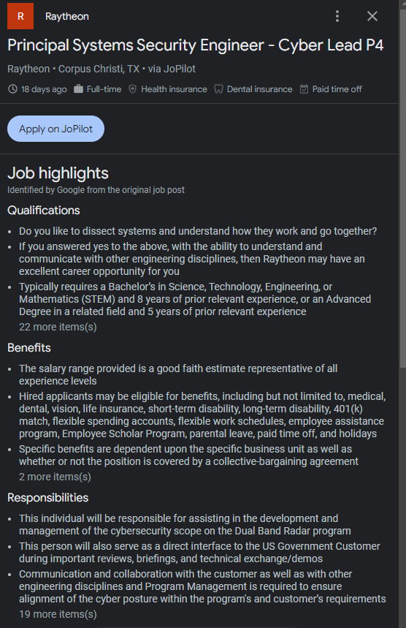
Job Description for my Dream Job

Slide 9
Comparison to Program of Study
GCU’s Master of Science in Cybersecurity can provide advanced, hands-on learning experiences that can prepare you to pursue potentially challenging, high-tech careers. This cybersecurity program imparts the following learning objectives and core competencies:
Risk assessment, countermeasures, security policies and frameworks
Ideologies of cyber-crime, identification of attack vectors and impact analysis of failed security measures
Policy perspectives on security design
Protection of intellectual property through encryption, hardware security and layered security defense strategies
.

Slide 10
Networking/Mentoring
With most computer/tech related careers moving to remote, networking is a must. With this, we must take part in exchanging ideas, information, and knowledge. Even through our classes at GCU networking and mentoring is a great way to learn and grow from one another, while expanding our network of contacts. Networking can occur anywhere at anytime, there are no financial burdens outright.

Slide 11
References
About the IEEE Computer Society. (n.d.). IEEE Computer Society. https://www.computer.org/about?source=nav
Developing & Connecting Cyber Security Professionals Globally. (n.d.). ISSA International.
https://www.issa.org/membership/developing-connecting-cyber-security-professionals-globally/
Home. (n.d.). National Cybersecurity Student Association. https://www.cyberstudents.org/
Master of Science in Cybersecurity. (n.d.). GCU. https://www.gcu.edu/degree-programs/master-science-cybersecurity
Principal Systems Security Engineer - Cyber Lead P4 at Raytheon. (n.d.). JoPilot. Retrieved July 17, 2024, from
https://jobs.jopilot.net/job/i38ha5ABNDRfCFvuJpuk0624?utm_campaign=google_jobs_apply&utm_source=google_jobs_apply&utm_medium=organic

